Slide 1


Slide 2
What we’re covering: Query Tuning With Indexes

Slide 3
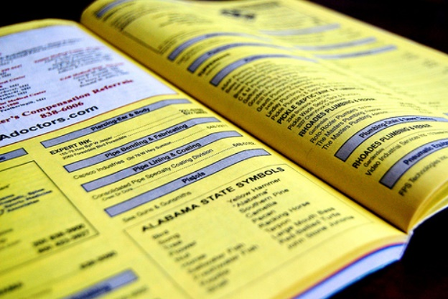
None of this

Slide 4
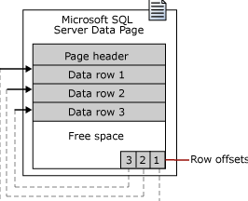
None of this

Slide 5
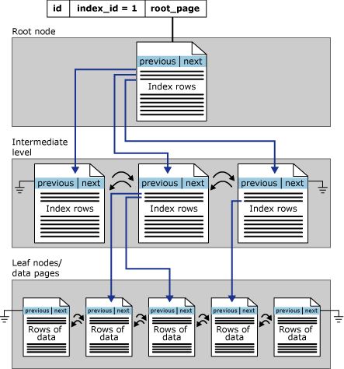
And none of this

Slide 6
No meme advice!

Slide 7

Your clustered index is a GUID ?

Slide 8

You don’t rebuild indexes every night ?

Slide 9

It doesn’t look like the most selective column is first

Slide 10

Oh no, page splits

Slide 11

Is this your index? <Name of Missing Index, sysname>

Slide 12
What I do care about

Slide 13

Making index tuning part of query tuning
Over and over, I hear stuff like
The query is slow, we have to rewrite it
<some operation> is always slow
People only care about their indexes when:
They scan instead of seek

Slide 14

Indexes are good for so much more!
What I’m going to show you
Some obvious, and some not-so-obvious, things that indexes change about query plans

Slide 15
Recap

Slide 16

Indexes do a lot of stuff!
With the right indexes, you can fix all sorts of problems in your queries
Good indexes can help your code scale
Good indexes can make better use of hardware

Slide 17

Bout it bout it
erikdarlingdata.com
erik@erikdarlingdata.com
@erikdarlingdata
That’s me.

